Slide 1


Spatial Frames of References in Signed Languages
Dominic Le
University of Toronto
Oksana Tkachman
University of British Columbia
WISSLR 2024

Slide 2
Outline
Background
Spatial Frames of Reference in Spoken Language
… in Signed Languages
Our contributions
Methodology: coding paradigm for individual signs
Implications

Slide 3
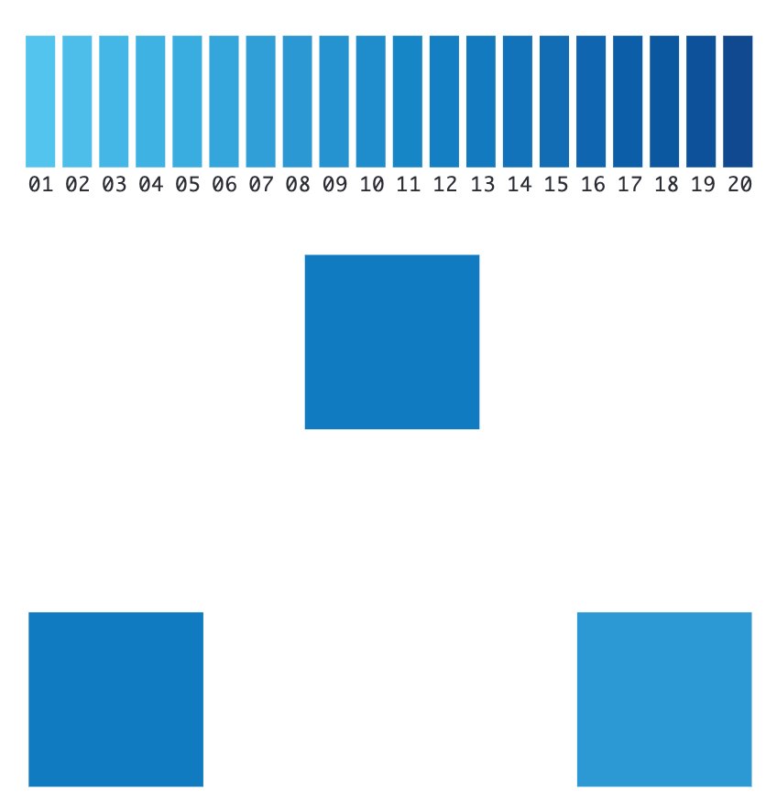
Colour Perception Varies Across Languages
(Winawer et al., 2007; widened)
Notes:
It is a well known phenomenon in psychology that due to varying cultural exposure, people identify a different set of colours. For example, in Russian, they have an obligatory distinction between light blues “goluboy” and darker blues “siniy” which is not present in English.
Researchers found that Russian speakers demonstrate significantly better discrimination across this blue spectrum than English speakers. The speakers can also prefer different colours (Japanese vs. English).
This lexiconal difference which broadly influences our cognition carries over to spatial representations.

Slide 4
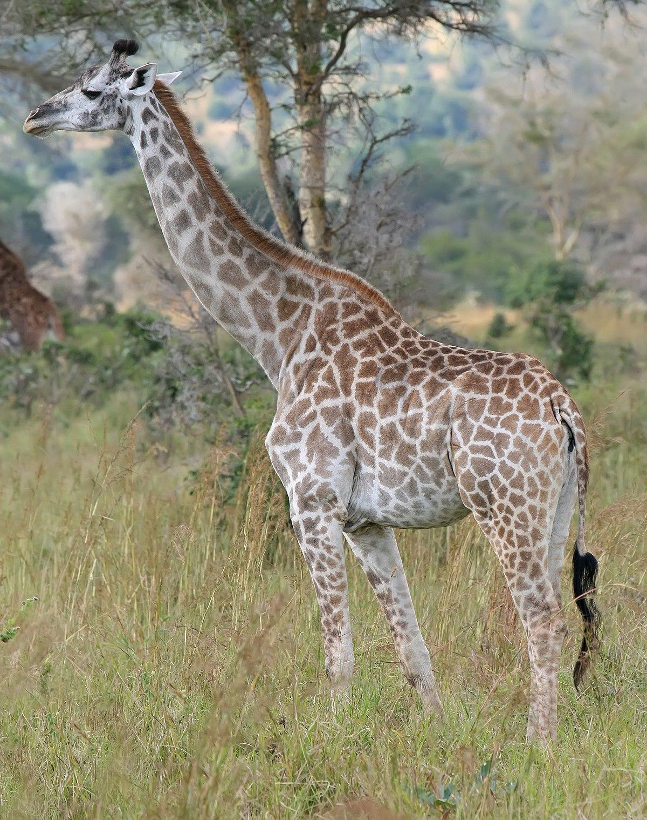

Spatial Terms Varies Across Languages
(Muhammad Mahdi Karim via Wikipedia, 2011. GFDL 1.2)
(Francis C. Franklin via Wikipedia, 2015. CC-BY-SA-3.0)
Egocentric Coordinates
Absolute Coordinates
(Levinson, 1992)
N
Left Right
W
E
S
Notes:
In English, we can say that something - a finch - is to the side, behind, or in front of something else - like a grove -, but in Guugu Yimithirr, a language spoken in North Queensland, Australia, we don’t not have words for our right, left, front, or back. Instead they use absolute coordinates like saying the finch is north, south, east (levinson, 1992), or west of the grove.

Slide 5
Absolute Coordinates
Figure
N
W
E
S
Figure
Ground
“The finch is ____ the giraffe!”
Figure

Slide 6
Intrinsic Coordinates
(Egocentric)
Figure
Figure
Perceiver
“The finch is ____ the giraffe!”
Figure

Slide 7
The finch is to the giraffe’s left
--------------------------------------------
The finch is left of the giraffe?

Slide 8
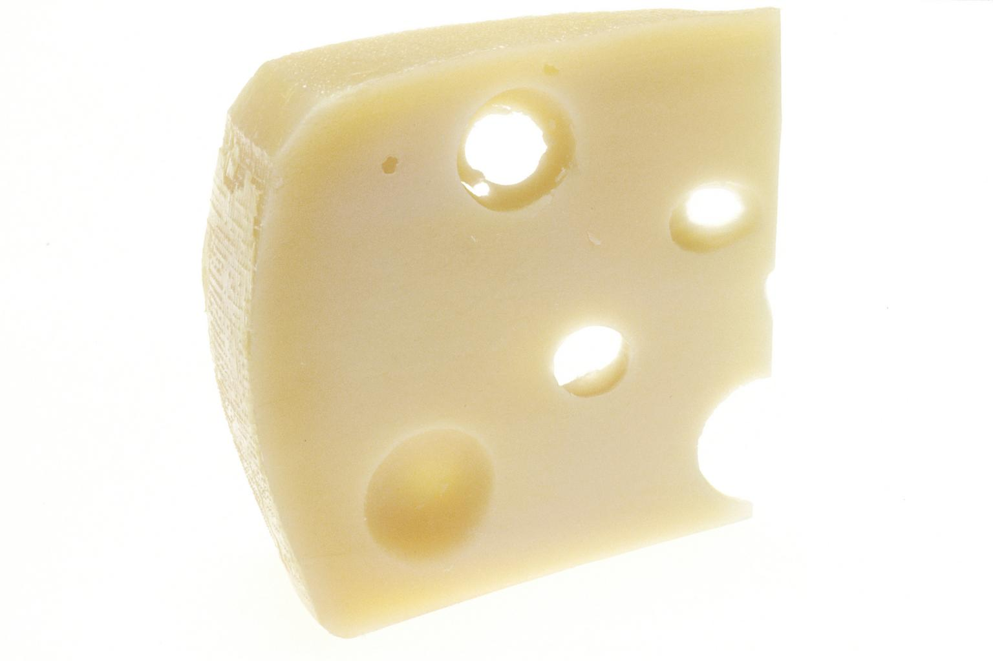
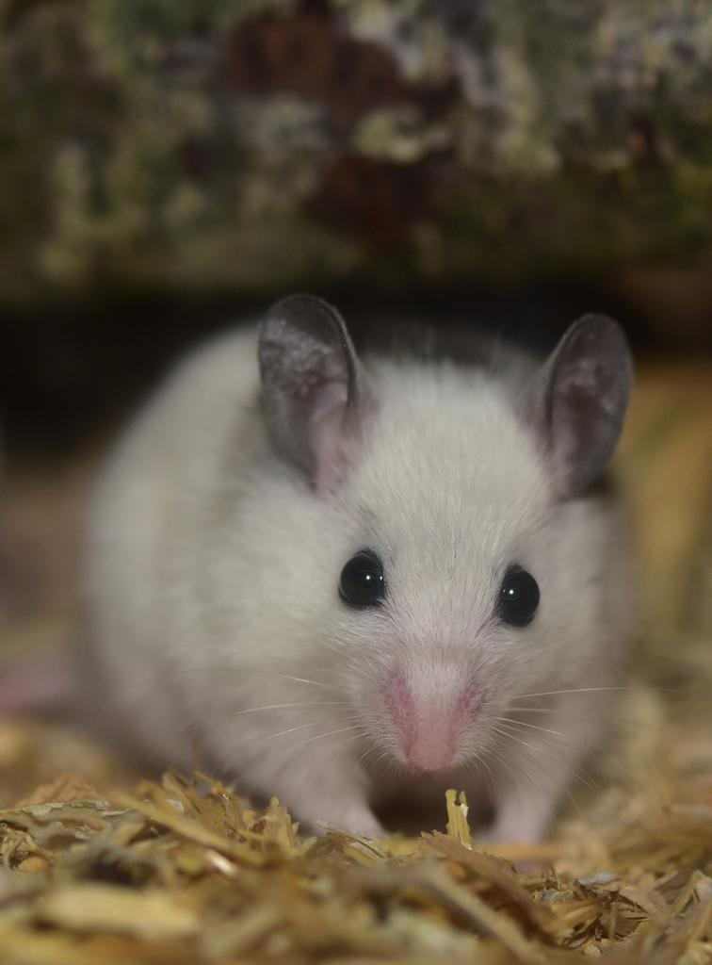
Frames of Reference: Intrinsic
When an figure object’s position is framed by a ground object (binary).
“The mouse is beside the cheese wedge.”
(National Cancer Institute Author: Renee Comet via Wikimedia, 1994.)
Figure
Ground
(Levinson, 2003)
(Sipa via Pixabay, 2015. CC0)

Slide 9
Frames of Reference: Relative
When a figure object is framed by a ground object and a perceiver (ternary).
“The mouse is left of the cheese wedge”
Figure
Ground
Perceiver
(Levinson, 2003)

Slide 10
Frames of Reference: Absolute
Figure
When a figure object is framed by a globally set axis.
“The mouse is north of the cheese wedge”
N
W
E
S
Global Axis
Ground
(Levinson, 2003)

Slide 11
More FoR: Direct vs Object-Oriented (Intrinsic)
When we have a binary relationship, is the figure object’s location framed by a perceiver or a ground object?
“The mouse is in front of you” vs. “The mouse is in front of the cheese”
Perceiver
Ground
Figure
(Danziger, 2010)

Slide 12
More FoR: Unoriented
When the location of objects is not framed.
“The mouse is by the wedge of cheese”
Ground
CHEESE,
WHERE??
Figure
(Palmer, 2003)

Slide 13
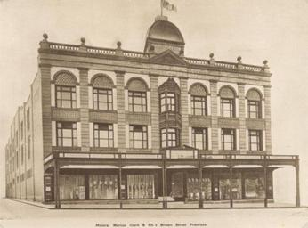
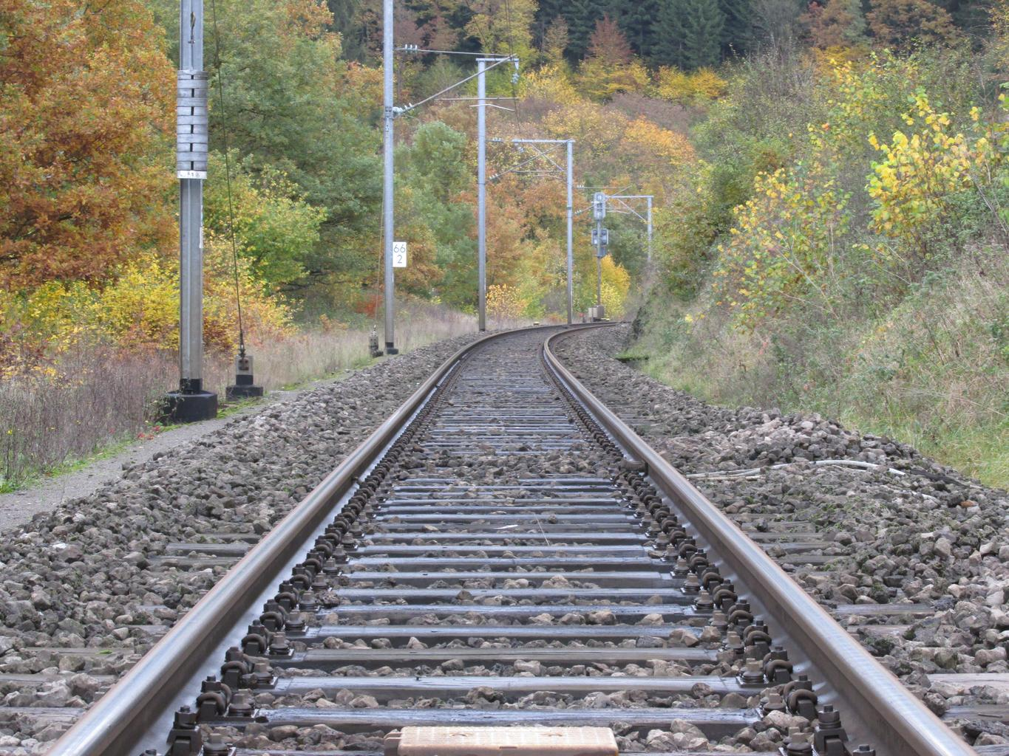
Verbal Frames of Reference Vary with Sociotopography
Sociopography: cultural association with landscapes and other topographical features
E.g. Urban populations prefer Egocentric Spatial Representations
E.g. Rural populations prefer Absolute Spatial Representations
The store is left of the tracks
The store is West of the tracks
(Dansen and Mishra, 2010)
Notes:
The use of frames of references differ across language and places where language is used, and its investigation is motivated by observed correlation between a community’s topographical environment - variation in landscapes and natural structures - and culture and the way the community prefers to represent objects in space (Bohnemeyer et al. 2014, 2015; Palmer 2015; Palmer et al. 2017). For example, whether a language is developed in rural or urban communities correlates with relative or absolute spatial representation. Speakers in urban communities would find themselves speaking like “the souvenir store is left of the train track” while speakers in rural communities are more likely to give directions like “the souvenir store is West of the train track”. In the same language, this variation is observed across topographies.

Slide 14
Outline
Background
Spatial Frames of Reference in Spoken Language
… in Signed Languages
Our contributions
Coding paradigm for individual signs
Implications

Slide 15
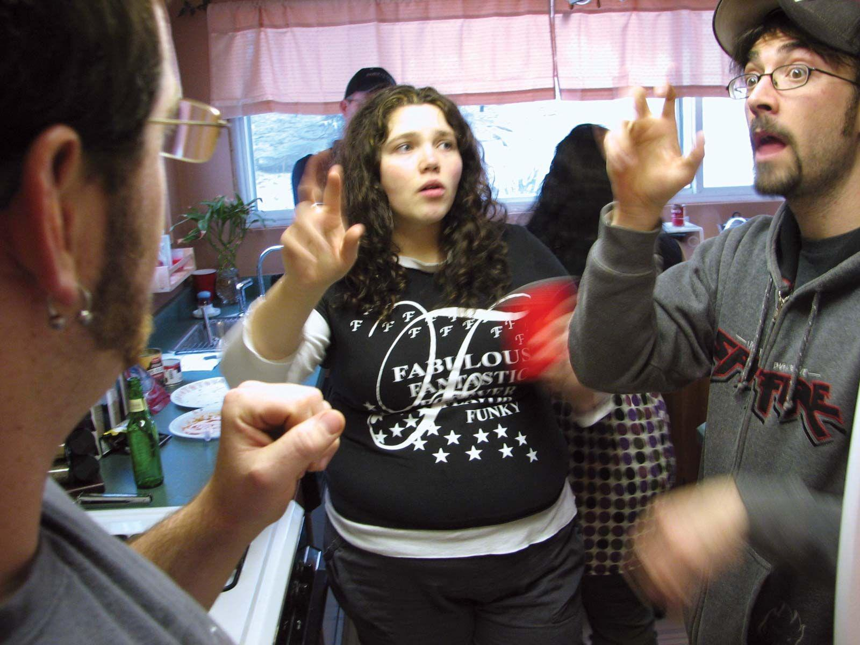
Signed Languages of the deaf and Space
Signers make use signing space for grammar (Sandler and Lillo-Martin 2006) and meaning ( Poizner 1987)
Some signed languages make use of all three basic frame of reference (Emmorey 2002)
Preference for spatial representation varies within language and from language to language (Eric and Milkovic 2007)
(David Fulmer via Wikipedia 2008. CC-BY-SA)

Slide 16
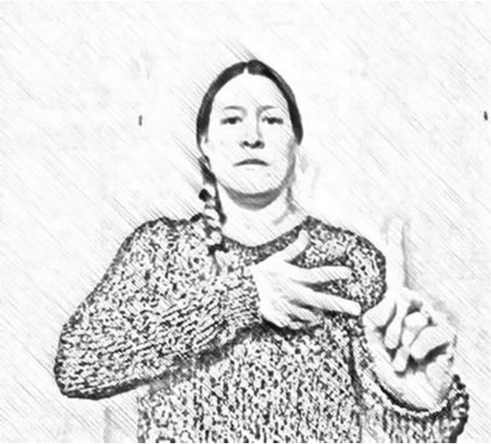
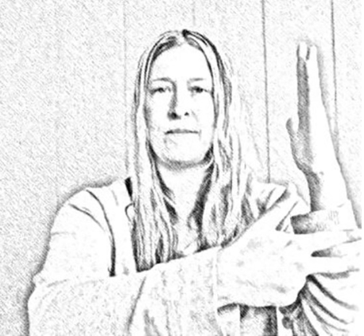
Frames of References in Signed Languages
Space conveys meaning
“The tree is in front of me”
“The car is in front of the tree”
(Tkachman, 2022)

Slide 17
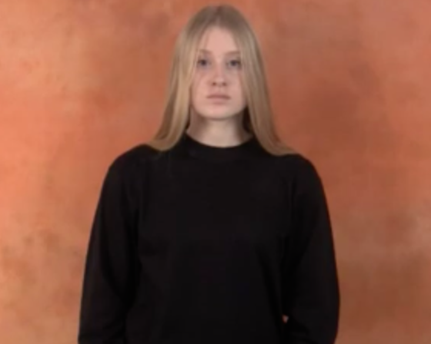
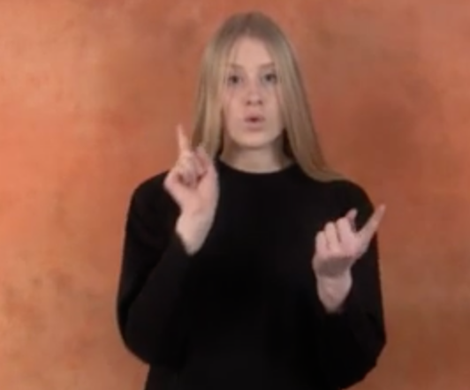
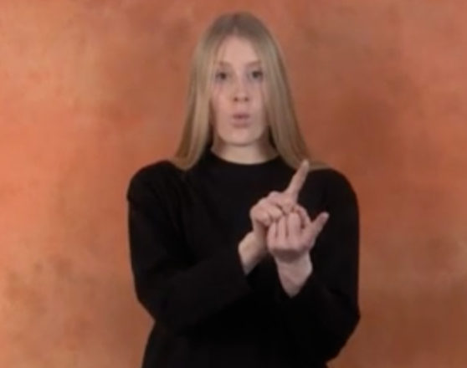
E.g. Estonian Signed Language - Meet
(spreadthesign.org)

Slide 18
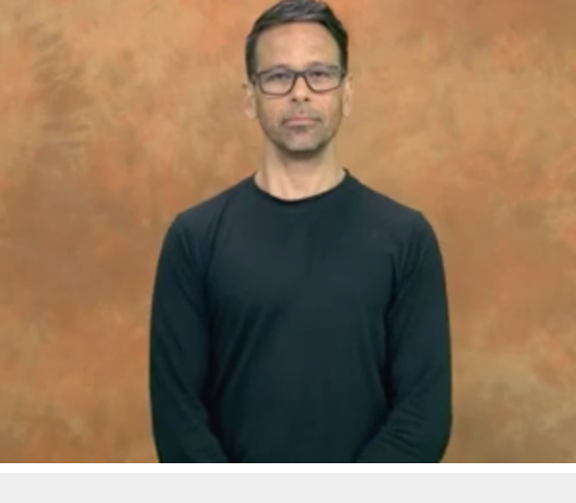
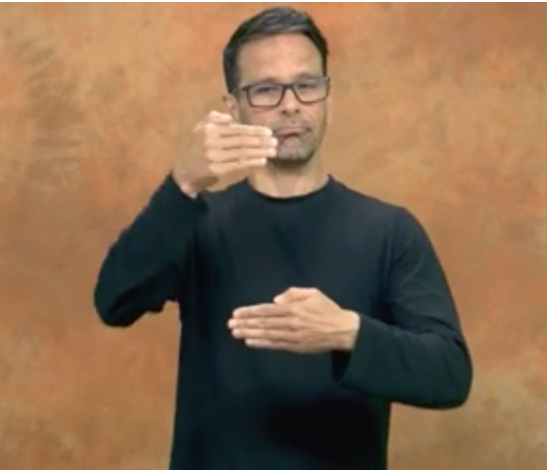
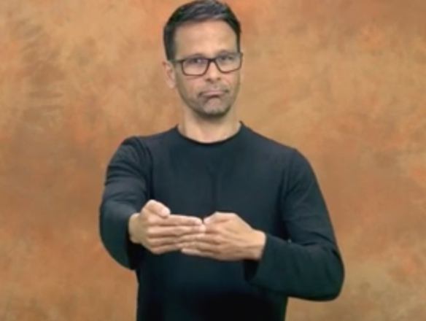
E.g. Portuguese Signed Language - Ahead
(spreadthesign.org)

Slide 19
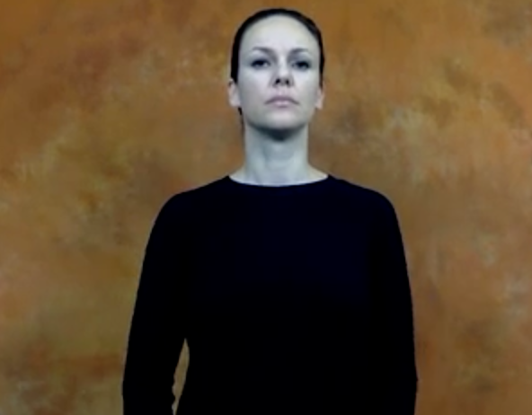
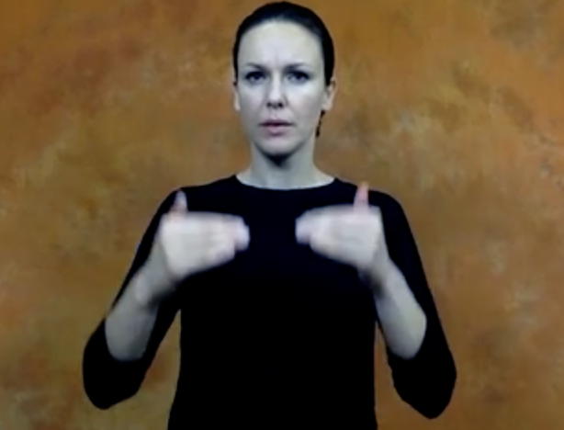
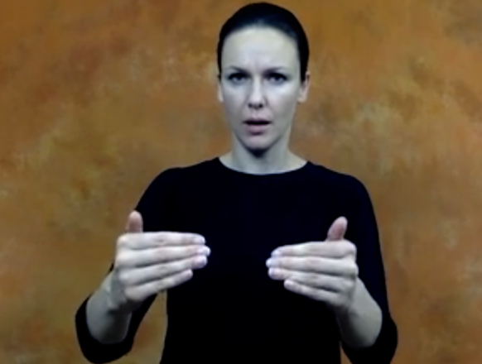
E.g. Croatian Signed Language - Ahead
(spreadthesign.org)

Slide 20
Outline
Background
Spatial Frames of Reference in Spoken Language
… in Signed Languages
Our contributions
Coding paradigm for individual signs
Implications

Slide 21
Methodology
Pilot Coding:
spreadthesign.org as our data corpus which includes 44 signed languages
76 spatial terms like “around,” “height,” “fall” not like “dog,” “cat,” or “cheese-grater”
Considered FoR such as
Direct, Object-Oriented, Relative, as well as Deictic, and Unoriented.

Slide 22
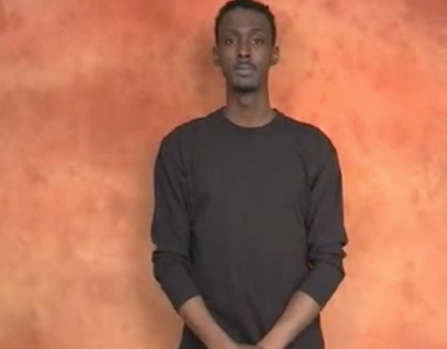
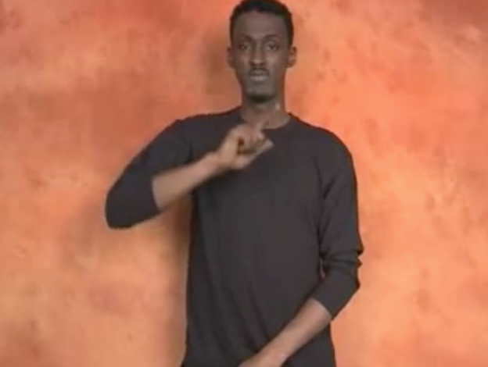
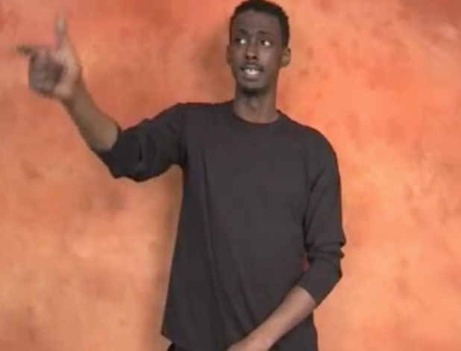
Deictic Example: British Signed Language - Far
the figure is pointed to, not represented
(spreadthesign.org)

Slide 23
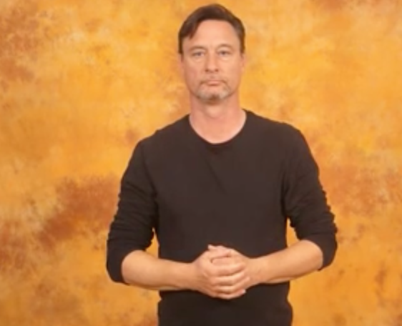
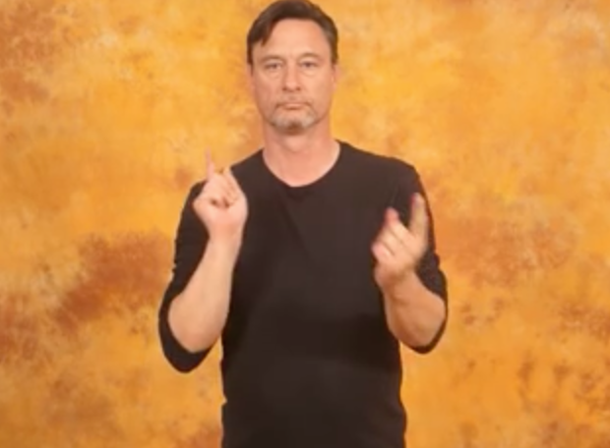
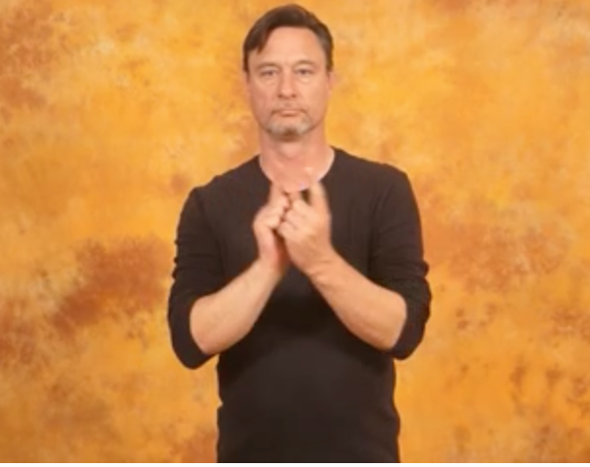
Unoriented Example: Austrian Signed Language - Meet
(spreadthesign.org)

Slide 24
Methodology
Pilot Coding:
spreadthesign.org as our data corpus which includes 44 signed languages
76 spatial terms like “around,” “height,” “fall” not like “dog,” “cat,” or “cheese-grater”
Considered FoR such as
Direct, Object-Oriented, Relative, as well as Deictic, and Unoriented.
Whether the sign was 2D/3D

Slide 25
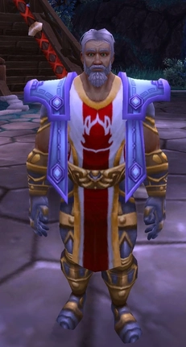
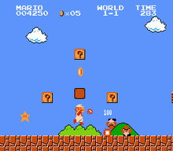
2D/3D
or
(Super Mario Bros. - Wikipedia)
(Leeroy Jenkins - Wikipedia)

Slide 26
Methodology
Pilot Coding:
spreadthesign.org as our data corpus which includes 44 signed languages
76 spatial terms like “around,” “height,” “fall” not like “dog,” “cat,” or “cheese-grater”
Considered FoR such as
Direct, Object-Oriented, Relative, as well as Deictic, and Unoriented.
Whether the sign was 2D/3D
Did not code lexical signs or composed signs.

Slide 27
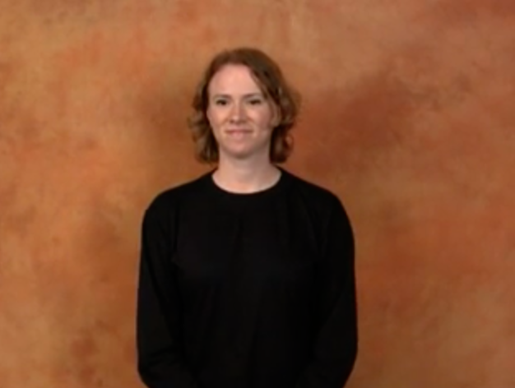
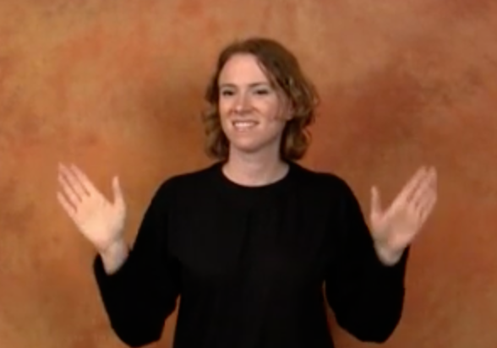
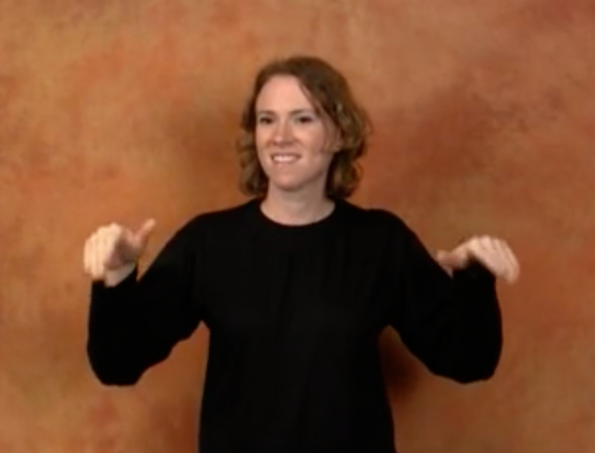
Lexical Signs - American - Fly (verb)
(spreadthesign.org)

Slide 28
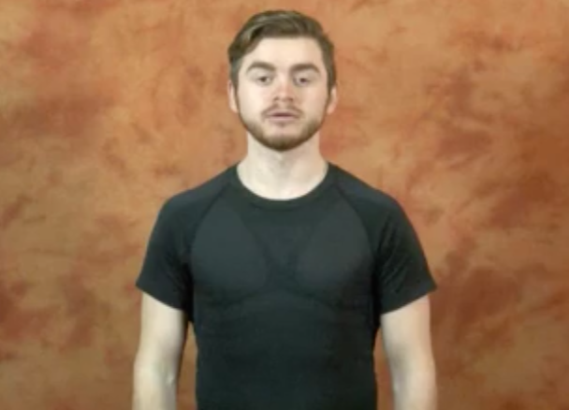
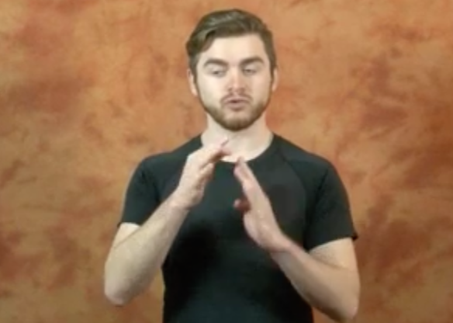
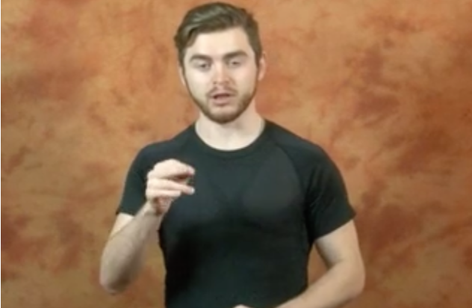
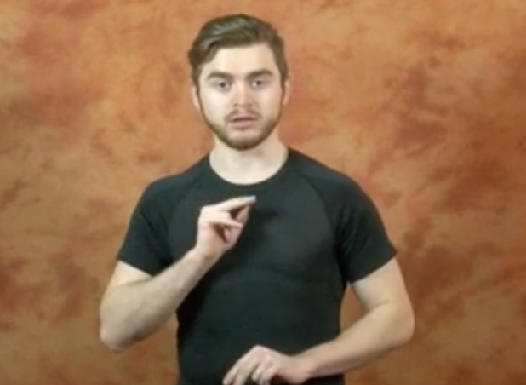
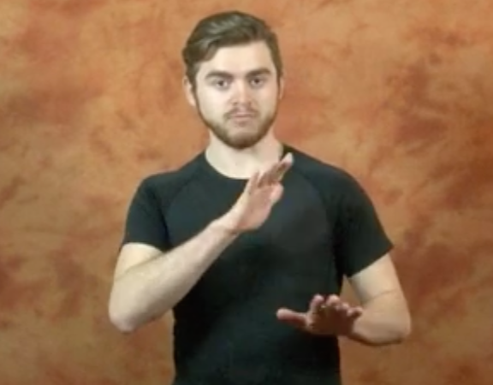
Composed Signs - Russian - Commute
(spreadthesign.org)

Slide 29
Methodology
Pilot Coding:
spreadthesign.org as our data corpus which includes 44 signed languages
76 spatial terms like “around,” “height,” “fall” not like “dog,” “cat,” or “cheese-grater”
Considered FoR such as
Direct, Object-Oriented, Relative, as well as Deictic, and Unoriented.
Whether the sign was 2D/3D
Did not code composed signs or lexical signs
American, British, Croatian, Turkish, Japanese, and Chinese Signed Languages

Slide 30
Future Directions for this Ongoing Project
Currently coding the same spatial terms for all signed languages in the corpus as we continue to test our spatial representation paradigm to categorize signs across languages.
This project seeks insight on:
Variation and consistency across modalities
How languages represent space (patterns, difficulties, etc)
Predictions will be made based on sociolinguistic factors and cognitive factors.

Slide 31
Overview
-Spatial Representation in language varies topographically.
-Frames of References capture the location of objects in space.
-Signed Language can embed frames of references into standalone concept representations.
-We are coding for object-oriented, direct, relative, deictic, and unoriented FoR.
Thank you Oksana Tkachman for putting this project together, helping synthesize this body of research for these slides, and encouragingly answering all my questions related or unrelated to the project while all being in a different time zone.
Thank you Hassan Khan for parallelling-coding signs with me, giving great advice all the time as a friend and a fellow R.A, and for the “how to talk” pdf.

Slide 32
References
Winawer, Jonathan & Witthoft, Nathan & Frank, Michael & Wulund, Lisa & Wade, Alex & Boroditsky, Lera. (2007). The Russian Blues Reveal Effects of Language on Color Discrimination. Proceedings of the National Academy of Sciences of the United States of America. 104. 7780-5. 10.1073/pnas.0701644104.
Levinson, Stephen C., Sotaro Kita, Daniel B. M. Haun Haun & Björn H. Rasch. 2002. Returning the tables: Language affects spatial reasoning. Cognition 84. 155–188.
Levinson, Stephen C. 2003. Space in language and cognition: Explorations in cognitive diversity. Cambridge, U.K.: Cambridge University Press.
Danziger, Eve. 2010. Deixis, gesture, and cognition in spatial frame of reference typology. Studies in
Language. International Journal sponsored by the Foundation “Foundations of Language” 34(1). 167–185.
Palmer, Bill. 2003. Linguistic frame of reference reconsidered. Proceedings of the 2002 conference of the Australian linguistics society, 1–12. Sydney: Macquarie University.
Dasen, Pierre R. & Ramesh C. Mishra. 2010. Development of geocentric spatial language and cognition: An eco-cultural perspective. Cambridge University Press.

